Slide 1

Demonym gazetteers
David Sánchez & Alex Pardo

Slide 2
Content
Introduction
Description of the problem
Our system
Evaluation
Results
Future work
Conclusions

Slide 3
Introduction
Demonym or gentilic, is a term for the residents of a locality.
Spain -> Spanish
Africa -> African
Build an automatic system capable to make transformations and generate the demonym from a country or city.

Slide 4
Description of the problem
Different types of transformations:
Adding and substitution
A lot of irregular cases.
One country or city can have more than one demonym.
Iran -- Iranian (also "Irani" or "Persian")

Slide 5
Our system
Two phases
Download demonym from Wikipedia, extract the rules and build the system.
Download unknown countries and cities and generate demonyms.

Slide 6
Our system
Extract the rules
Training phase
Download demonyms from Wikipedia
Generate rules
Show rule histogram
Init
Obtain results
Test phase
Find demonyms for cities and countries
Download cities and countries
Result

Slide 7
Extract rules
Extract rules
Two types of rules:
1: Remove the current suffix and add another one.
2: Add a suffix to the word.
Example: Africa -> African
1:
a
n
2:
n

Slide 8
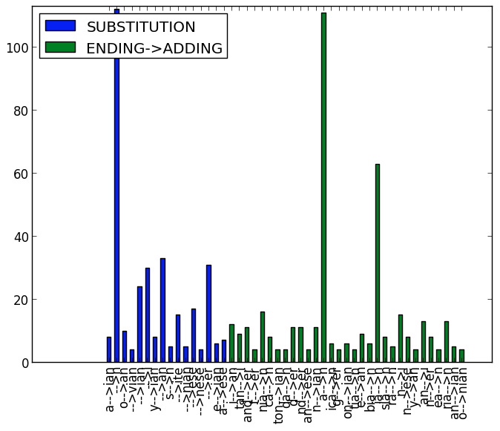
Extract rules - Histogram

Slide 9
Obtain results
Download new countries and cities.
Apply all the possible rule.
Find all the occurrences on the WP page of the location.

Slide 10

Evaluation
In order to evaluate the system we compute the accuracy:

Slide 11
Results
410 training samples
31 add and 16 replace rules
total of 47 rules (TH = 3), originally 791
55 TP for countries, 89 samples: 61.8%
89 TP for cities, 1751 samples: 5.08%

Slide 12
Discussion
Good values for countries
Bad results for cities:
System trained with countries
Some WP pages for cities are incomplete (the demonym does not appear)
High irregularity

Slide 13
Future work
Use a larger number of training examples
Use more complex models (e.g. analyse the words in terms of lexemas and its derivations)
Try to generalize the rules

Slide 14
Conclusions
We needed a lot of regular examples and discard the irregular forms.
The combination of the two types rules is a good option since explains the main cases.
Difficult to obtain good results because exist a lot of irregular cases.

Slide 15
Questions?

